Slide 1
Automated Auditors, LLC Christy Warner, President www.findapfraud.com

Slide 2
Too
Much
data?

Slide 3
Accounts Payable (A/P) Data Audit
Leverage data to gain insight into A/P vulnerabilities
Provide service with minimal time required from your staff
Customized fraud-detection algorithms designed to identify overpayments and potential fraud
Final executive summary report

Slide 4
$8 Million Loss
In the payables department of Advance Publications, an email was received from a known vendor indicating a change in bank account numbers. Since the email came from what looked like a legitimate vendor, the bank account was changed in the vendor file. Unfortunately, this vendor number was being hijacked by “Mr. Surface”, who successfully routed $8 Million to his private bank account.
Did you know data forensics can help prevent and detect this fraud scenario?

Slide 5
A/P Data Forensic Audit
Duplicate payments
Duplicate vendors
Benford’s Law
Sequential invoice numbers
P-card “double dipping”
P-card anomalies
Bank account changes
Vendor / employee crosscheck
“Shell” or fictitious vendors

Slide 6
Examples
How do we identify fraud and overpayments?

Slide 7
Billing Scheme: Shell Company
One type of billing scheme we have seen is the “Shell Company” or Fictitious Vendor scheme. In this scheme, an employee will set up a shell, or fictitious, company for the purposes of committing fraud. The employee will fabricate a name, often similar to the name of another vendor that the company uses. The employee will typically open a bank account in the shell company’s name, so he/she can deposit and cash the fraudulent checks.
Data forensics can help prevent and detect this fraud scenario
Algorithms applied: vendor/employee crosscheck, vendor names with very similar but non-exact spellings, sequential invoice numbers, cross-check with private mail boxes at UPS, Fedex, Parcel Post and others

Slide 8
Duplicate Payments
Typically, our duplicate payment identification is enough to cover the cost of the data forensic audit. We pride ourselves with the most advanced data matching techniques that will detect even those hard-to-catch dupes or erroneous payments.
Examples:
Invoice # 00010213-A will be matched with Invoice # 10213A
Monthly payments of $302.15 to one vendor, made to another vendor accidentally will be caught
Partial payments that add up to another larger dupe payment will be caught, such as $12,225 + $2,500 = $14,725. We found a $200,000+ duplicate payment with this method.

Slide 9
Procurement Card (P-Card) Analysis
P-Card fraud can take several forms. In addition to running the below algorithms, we allow the data to guide us in finding other aberrancies.
Examples:
Payment made on P-Card and through A/P via an invoice, common with Travel & Expense vouchers (“double dipping”)
Gift cards, gas, or other personal payments made via P-Card
Payments made to unusual vendors
Frequent purchases just below approval amounts, i.e. $999.00
Collusion with other p-card holders to circumvent approval maximum
Payments with rounded amounts, i.e. $9,000

Slide 10
Our process is easy
You decide which algorithms that best fit your needs ~ pricing is based upon the number and nature of the algorithms
Compile Executive Summary
Synthesize results from fraud detection algorithms into an Executive Summary Word or PDF document that can be shared with Management or other staff. Will describe methodology and results. All detailed results will be delivered via Excel.
03
Data Acquisition
Send us your vendor file and payables files via secure FTP. Conduct initial data trend and data quality analysis.
Conduct Data Analysis
Run selected data forensic algorithms. You can decide which algorithms would be the most effective in assessing and detecting system vulnerabilities.
01
02

Slide 11
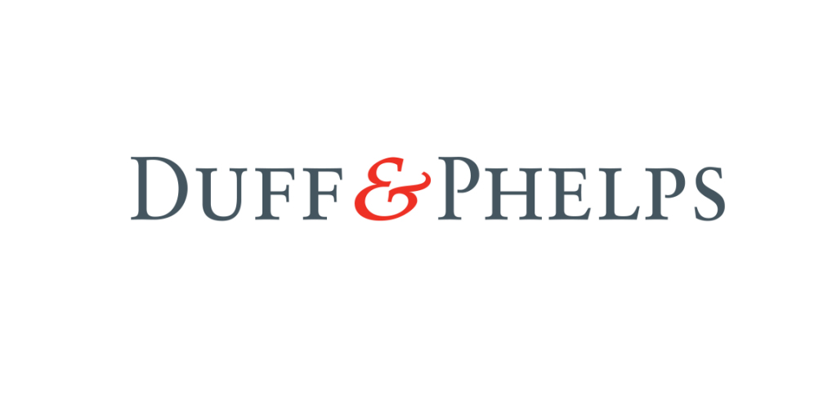
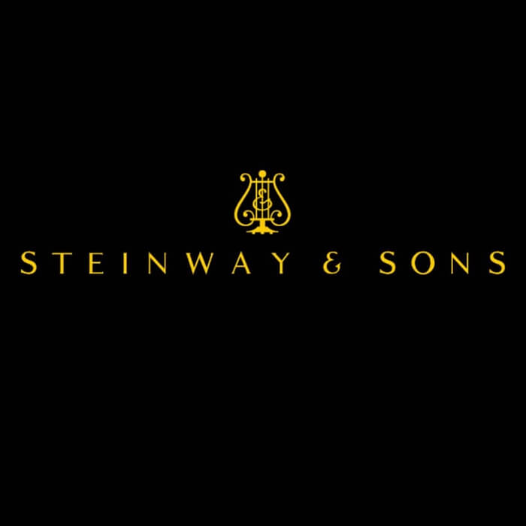
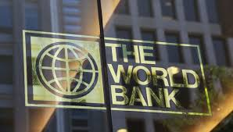
Previous Clients Include
The Coast Guard
USC Keck Hospital
Duff & Phelps
Tesla vendor file audit
National Football League
The World Bank
Middlesex County, NJ
Steinway

Slide 12
What do our clients say about us?
“Christy and I have collaborated on many client projects in the past. Christy is one of the smartest data scientist/fraud examiners that I have worked with during my career. She quickly understands the data set and structure and what we need to find. Then she goes to work and does her algorithm magic and makes the data speak. These are critical skills necessary in today’s complex business environment in order to effectively find the data anomalies and find the fraud… and clients love her!”
– Bruce Dubinsky, Duff & Phelps, CPA, MsT, CFF, CFE, CVA, CAMS, MAFF
“Ms. Warner is second to none in her line of work. Her ability to dig into the details, that quite frankly you're probably missing, is simply amazing. She's easy to work with and I highly recommend you hire her...especially if you're a retail loss prevention professional. All too often traditional retail LP is just that...traditional. Ms. Warner gets you out of that comfort zone when she put her forensic lenses on your corporate finance division."
– Loss Prevention Director, Government Confidential

Slide 13
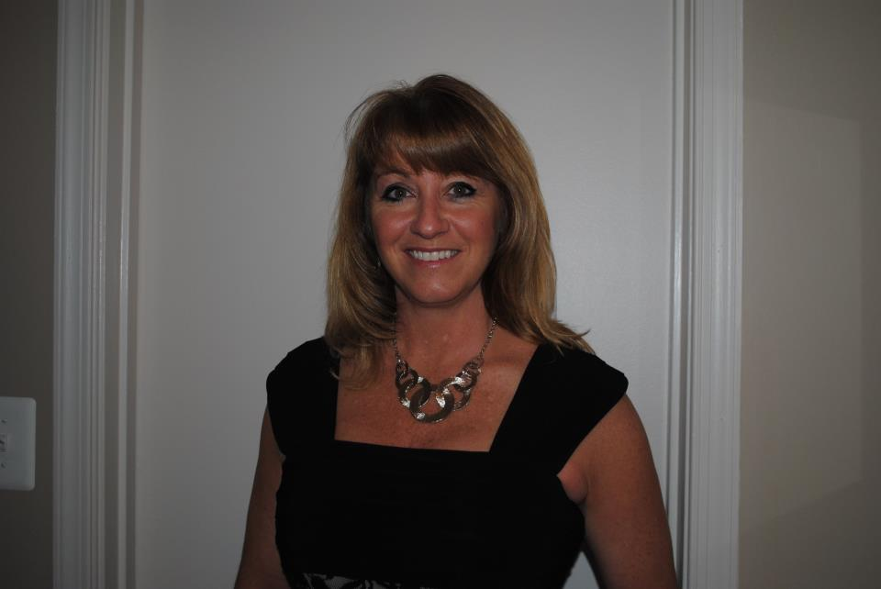
Christy Warner, President
Christy Warner is a seasoned fraud detection specialist who leverages SAS software to solve complex data problems. She has a degree in Math and a minor in Statistics from James Madison University and 25 years applying that knowledge to detect Accounts Payable fraud and healthcare claims fraud.
Visit https://www.findapfraud.com for additional case studies and information on our services.
christy@findapfraud.com
571-606-7743 call or text

